Slide 1
Economic Time Series Modeling of U.S. Housing Prices
Presented by:
Vikas Garg
Yasin Khan
Shirley Lu
Timothy Roberts
Yi Fan Tang
Wesley Tillu
Master of Engineering | Financial Engineering Project
May 11th, 2009

Slide 2
Outline
Introduction
  Overview of Housing Market
State Results
  60 Month Forecasts
Modeling Methodology
  Drift and Volatility Modeling
Forecasting Methodology
  Curve Fitting Macroeconomic Predictors
Conclusion
  Points to Investigate Further

Slide 3
Introduction / Hook
I. Introduction
[Housing Market Headlines]
Introduction
State Results
Methodology
Forecasting
Conclusion

Slide 4
Solution
I. Introduction
The need for better/more refined housing models
Introduction
State Results
Methodology
Forecasting
Conclusion

Slide 5
Our Goal
I. Introduction
Current uncertainty in the housing price market
Potential for devising a profitable Mortgage Backed Securities (MBS) trading strategy
Requires: Developing efficient and robust time series models to understand the housing price process
  Understand the drivers of housing price economics
More importantly: to be able to utilize these models to forecast the evolution of housing prices over a medium to long term horizon
Introduction
State Results
Methodology
Forecasting
Conclusion

Slide 6
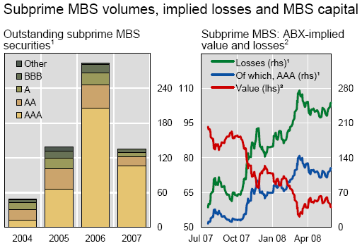
Purpose and Objectives
Purpose / Uses
Housing prices drive Mortgage-Backed Securities (MBS) valuation
Devise profitable trading strategies
Objectives
Develop efficient and robust models to understand the housing price process
Forecast the evolution of housing prices over medium to long term horizon
1 In billions of US dollars. 2 Assumes unrated MBS bonds are written down completely and ABX prices are applied to the respective outstanding MBS volumes. 3 As a percentage of par
Sources: ABSNET.net; JPMorgan Chase; UBS; BIS calculations.
Introduction
State Results
Methodology
Forecasting
Conclusion

Slide 7
Housing Price Index (HPI)
I. Introduction
What is it?
  Measures movement of single-family house prices
  Quarterly, state-level data from 1975 – 2008
  Updated based on repeat-transaction methodology
  Published by the US Office of Federal Housing Enterprise Oversight (OFHEO) based on Fannie / Freddie data
Disadvantages
  Jumbo loans >$417,000 and risky subprime sales not included
  Continually updated with every repeat transaction
Introduction
State Results
Methodology
Forecasting
Conclusion

Slide 8
Current Housing Price Situation
Downturn in home prices has left about 20% of U.S. homeowners owing more on a mortgage than their homes are worth (WSJ, May 6, 2009)
  Moody's Economy.com estimates that is 78.2 million owner-occupied single-family homes
Implications
  Falling prices make it more difficult for homeowners in financial trouble to refinance or sell their homes
  Inability to take advantage of lower interest rates
  Many borrowers took out home-equity lines of credit at the time of purchase and have fully tapped the amount they can borrow
Introduction
State Results
Methodology
Forecasting
Conclusion

Slide 9
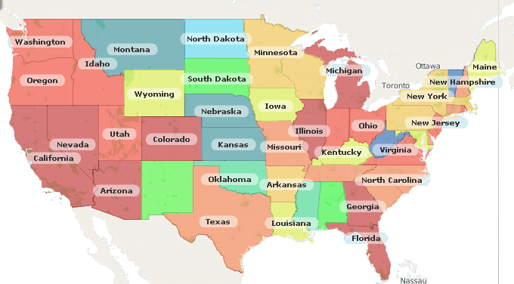
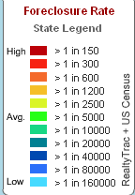
Distribution of States
II. State Results
States by Foreclosure Rate
Introduction
State Results
Methodology
Forecasting
Conclusion

Slide 10
Selected States
II. State Results
High Foreclosure Rate (>1 in 150)
  Arizona
  California
  Florida
Mid-level Foreclosure Rate (>1 in 600)
  Ohio
  Texas
  Idaho
Low Foreclosure Rate (>1 in 20,000)
  Kansas
  South Dakota
Introduction
State Results
Methodology
Forecasting
Conclusion

Slide 11
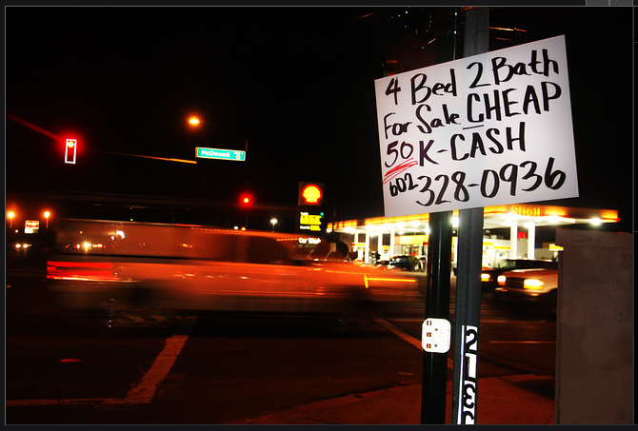
Arizona
II. State Results
Phoenix and its suburbs are among the hardest hit by the foreclosure crisis. Avondale, just west of Phoenix, grew from 35,000 residents to 70,000 residents between 2000 and 2005, the heyday of the housing boom. Now many residents are unable to sell their houses except at fire-sale prices.
Introduction
State Results
Methodology
Forecasting
Conclusion

Slide 12
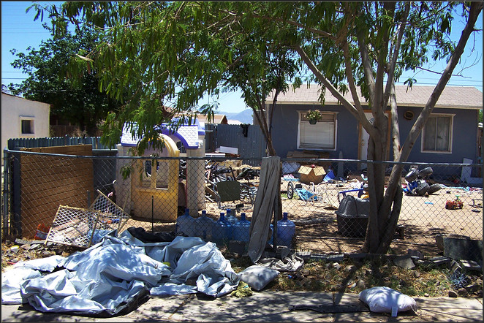
Arizona
II. State Results
Appraisers valued the decayed house at $132,000 for a $103,000 mortgage before the housing bubble bursted. Under foreclosure, the house recently sold for $18,000.
Introduction
State Results
Methodology
Forecasting
Conclusion

Slide 13
California
II. State Results
Background Information
  Household income is
  Historical HPI has been
Current Climate & Future Outlook
  Bad Sign: Pre-foreclosure notices up 80% in Q1’09
  Delinquencies on dues to homeowner associations on the rise, some areas as high as 15%
  New home construction at 25-year low
  Senate Bill 15: $10,000 tax credit to purchase new unoccupied home
Introduction
State Results
Methodology
Forecasting
Conclusion

Slide 14
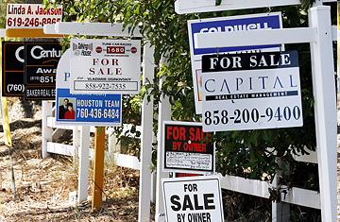
California
II. State Results
Introduction
State Results
Methodology
Forecasting
Conclusion

Slide 15
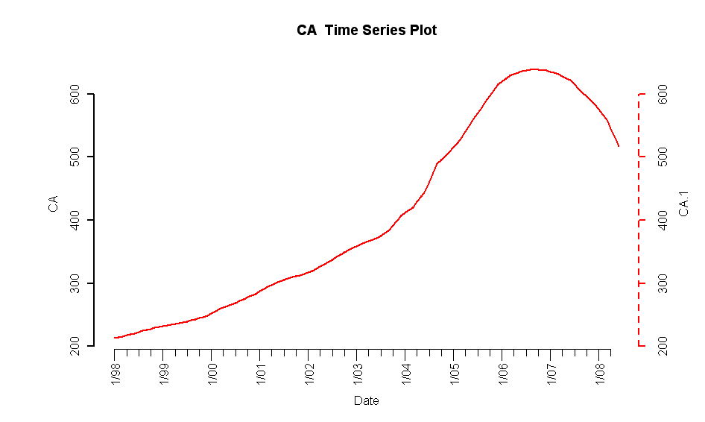
California
II. State Results
Historical HPI from January 1998 to June 2008
Introduction
State Results
Methodology
Forecasting
Conclusion

Slide 16
Florida
II. State Results
Introduction
State Results
Methodology
Forecasting
Conclusion

Slide 17
State 4
Introduction
State Results
Methodology
Forecasting
Conclusion

Slide 18
State 5
Introduction
State Results
Methodology
Forecasting
Conclusion

Slide 19
Modeling Approach
III. Modeling Methodology
Drift Model
  Multiple linear regression
  Predictors: Macroeconomic Factors
  Response: Housing Price Index (HPI)
  Requirements: Unit-root stationarity of the residuals
Volatility Model (if needed)
  Model autocorrelation of residuals
  Time series modeling using ARFIMA / GARCH
Introduction
State Results
Methodology
Forecasting
Conclusion

Slide 20
Macroeconomic Variables
III. Modeling Methodology
Demand Side
  Unemployment Rate
  Population Size
  Median Income
  30-year Commitment Rate (proxy for “Cost of Credit”)
  Mortgage Originations (proxy for “Availability of Credit”)
Supply Side
  Building Permits Issuance (proxy for “Housing Stock”)
  Foreclosures
Introduction
State Results
Methodology
Forecasting
Conclusion

Slide 21
Modeling Challenges
III. Modeling Methodology
Data
  Influential Observations in the pre-1990 HPI Data
    Accuracy of the data in this time period is questionable
    Hindered stationarity of residuals
    Removed using the Grubb’s test for outliers
  Data primarily available in quarterly intervals
    Linear interpolation used to obtain monthly estimates
Regression Coefficients
  T statistic not an accurate indicator of statistical significance
  Predictor may still explain a substantial amount of variation in the HPI
Introduction
State Results
Methodology
Forecasting
Conclusion

Slide 22
Volatility Modeling
III. Modeling Methodology
Goal / Purpose
  To model serial autocorrelations in residuals
  To stabilize variance and volatility clustering from drift model
  Original residuals should already be stationary
Univariate Time Series Modeling
  Auto-Regressive, Moving Average (ARMA)
  General Auto-Regressive Conditional Heteroscedasticity (GARCH)
Introduction
State Results
Methodology
Forecasting
Conclusion

Slide 23
Building Forecasts
IV. Forecasting
Variable Forecasting
  Examine trends in each of 7 macroeconomic variables
  Determine key assumptions for each variable
  Project out to 60 months
Volatility Forecasting
  Based on ARMA/GARCH models built
  Explains additional model volatility
Introduction
State Results
Methodology
Forecasting
Conclusion

Slide 24
Variable Forecasts / Assumptions
IV. Forecasting
Variable
Assumption
Unemployment Rate
Population Size
Median Income
Mortgage Originations
30-Year Commitment Rate
Building Permits
Foreclosure
Periodic trend
Linear growth
Stationary about 2-year mean
Zero for 24 months
Analyst forecasts (Global Insight)
Move about pre-bubble mean
Recovery in 24 Months
Demand
Supply
Introduction
State Results
Methodology
Forecasting
Conclusion

Slide 25
Sample Forecasts
IV. Forecasting
Curve Fitting for California
Introduction
State Results
Methodology
Forecasting
Conclusion

Slide 26
Sample Forecasts
IV. Forecasting
Curve Fitting for Florida
Introduction
State Results
Methodology
Forecasting
Conclusion

Slide 27
Conclusion
V. Conclusion
Introduction
State Results
Methodology
Forecasting
Conclusion

Slide 28
Sources
FOR CALIFORNIA
http://www.dre.ca.gov/pdf_docs/Op_Ed_New_Home_Credit_%202_26_09.pdf
http://blogs.wsj.com/developments/2009/05/06/another-sign-of-foreclosure-trouble-in-california/?ref=patrick.net
http://blogs.wsj.com/developments/2009/04/24/foreclosures-set-to-soar-in-california/
FOR Jumbo Mortgages
http://online.wsj.com/article/SB123543726577454673-search.html
FOR Pictures
http://online.wsj.com/article/SB123543721679054667.html
http://online.wsj.com/video/bank-decides-to-demolish-new-homes/509981D0-7AAF-4A29-AE46-A490D7FE2A93.html

Slide 29
Drift Modeling
I.
II.
III.
I.
I.

Slide 30
II. Methodology
Drift Modeling
I.
II.
III.
I.
I.

Slide 31
I. Methodology
Drift Modeling
I.
II.
III.
IV.
V.

Slide 32
II. Methodology
Drift Modeling
I.
II.
III.
IV.
V.

Slide 33
I. Methodology
Drift Modeling
I.
II.
III.
IV.
V.

Slide 34
Data source and breakdown
OFHEO
Published by the US Office of Federal Housing Enterprise Oversight
  1975 – 2008 quarterly
I.
Introduction
II.
State Results
III.
Methodology
IV.
Forecasting
V.
Conclusion

Slide 35
II. Methodology
Drift Modeling
I.
II.
III.
IV.
V.

Slide 36
Drift Modeling
I.
Introduction
II.
State Results
III.
Methodology
IV.
Forecasting
V.
Conclusion

Slide 37
Drift Modeling
I.
Introduction
II.
State Results
III.
Methodology
IV.
Forecasting
V.
Conclusion

Slide 38
Drift Modeling
I.
Introduction
II.
State Results
III.
Methodology
IV.
Forecasting
V.
Conclusion

